Slide 1
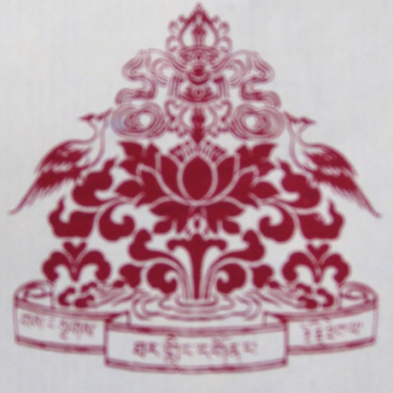
Tolu Tharling Monastery
Preservation Appeal
2019

Slide 2
Within a Pristine Forest Landscape with a view of the entire Himalayan Range

Slide 3
Between the Solu Kumbu and Okhaldunga District of Eastern Nepal, in the range of Pike Lhamje near Mount Everest

Slide 4
Where Sherpa people have raised cattle for centuries

Slide 5
And Meditation Practitioners have done retreat in secret caves for hundreds of years

Slide 6
Guru Rinpoche Body Print Cave

Slide 7
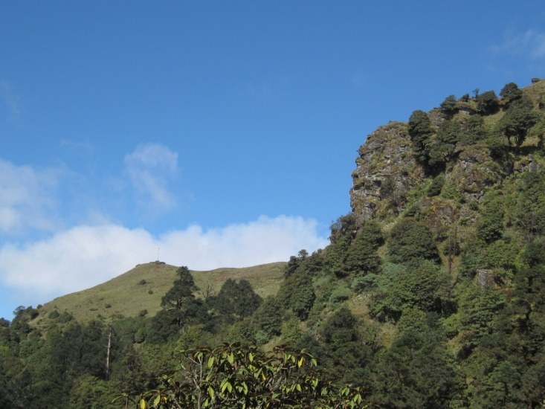
Path to Guru Rinpoche Body Print Cave

Slide 8
Ekajati Protector Cave

Slide 9
Lies the 400 year old heartland of Tolu Tharling Monastery

Slide 10
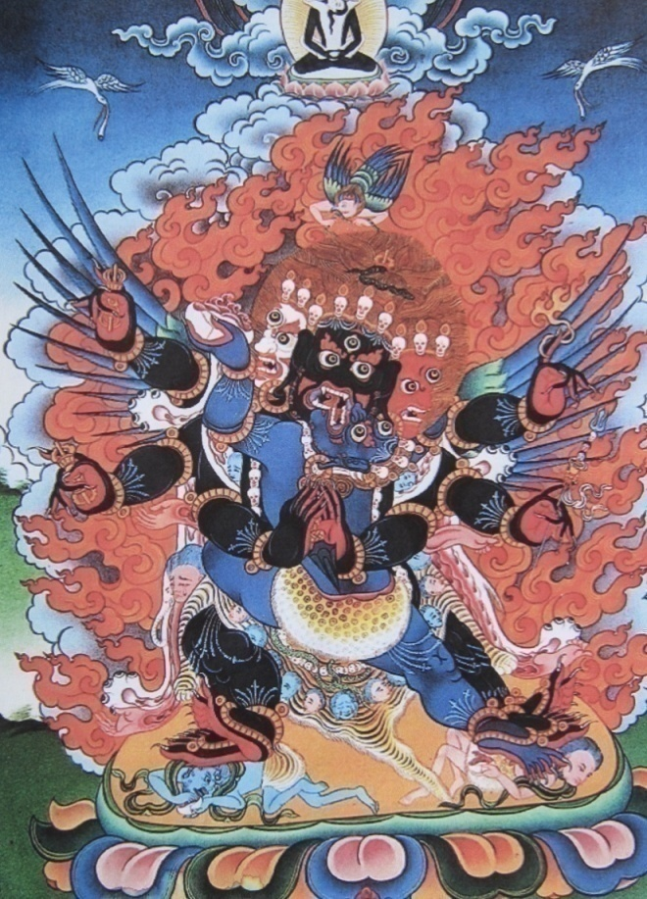
Nyingmapa Dzogchen Secret Mantra Vajrayana
Introducing our Lineage

Slide 11
MONASTERY SEAT HOLDERS
Kushok Ngawang Yonten Norbu Rinpoche
Kushok Mangdhen Rinpoche
Kushok Tulku Rinpoche
Kyabrok Tulku Ngawang Tenzin Chhothar Rinpoche
Lama Ngawang Tsultrim Rinpoche (Current Head Lama)

Slide 12
Kushok Ngawang Yonten Norbu Rinpoche
Notes:
Ngawang Yonten Norbu Rinpoche was the recognized reincarnation of Ramna Tsewang (founder of Jyalsa Monastery in Solu Kumbu), Langtang Mingyur Dorje, and Mingyur Dorje of Kham. Well known for having built the Chewang Monastery in Solu Kumbu in 1935, 10 years later nearing the end of his life he came to Tholaka to do retreat in 1945.
Once arrived, he was requested by Rinzi Lhakpa, grandfather of current head Lama Ngawang Tsultrim, and his cousins for him to help them build a Gonpa in the retreat location. Rinpoche invited his brother, Kushok Mangden Rinpoche to assist with this request. Kyabje Kushok Tulku Rinpoche is his current incarnation.

Slide 13
Kushok Mangdhen Rinpoche
Notes:
Spending most of his life in retreat, Kushok Mangdhen Rinpoche was renowned as a great Yogi and Dzogchen Master, and excellent Astrologer and Tibetan Medicine practitioner. Attracting many students from India and Nepal, Rinpoche taught Dzogchen teachings to a number of high Rinpoche’s and Indian Babas. Having spent many years in retreat at Charok in Thame Monastery, Rinpoche was invited by his brother, Tulku Ngawang Yonten Norbu Rinpoche, to build and guide Tolu Gonpa, as its Head Lama.
Kushok Mangdhen Rinpoche stayed at Tolu Gonpa for 38 years (1947 – 1985), after which he returned to Charok retreat until the end of his life. Current head Lama, Ngawang Tsultrim Rinpoche lived with Rinpoche from the age of 5 years, and all teachings were passed on to him.

Slide 14
Kushok Tulku Rinpoche
Notes:
Kushok Tulku Rinpoche (Tulku Ngawang Lozang Gyaltso) is seven times a reincarnate lama. His main teachers include H.H. Kushok Mangdhen Rinpoche, H.H. Lama Thondrup Rinpoche (the previous life of the current H.E. Thami Tulku Rinpoche), and H.H. Dzatrul Ngawang Tendzin Norbu Rinpoche.
H.E. Kushok Tulku's previous incarnations include H.H. Thame Kushok Tulku Rinpoche, by name of Ngawang Yonten Norbu, founder lama of Chiwang Monastery in Solu Khumbu, Nepal; H.H. Trinchen Ratna Tsewang Rinpoche, founder of Jyaltse Monastery in Jyaltsa Solu, Nepal; H.H. Langtang Mingyur Dorje of Langtang, founder of Langtang Monastery in Rasa, Nepal; H.H. Domar Mingyur Dorje of Kham, founder of Palyul Monastery in Tibet and Tertön revealer of Namcho; and H.H. Trulshik Chenpo of Khatok.

Slide 15
Kyabrok Tulku Ngawang Tenzin Chhothar Rinpoche
Notes:
Born as the third son of Rigzin Lhakpa and his mother Pasi in Namche Bazaar Solu Kumbu, Kyabrok Tulku Ngawang Tenzin Chhothar Rinpoche was recognized as a Tulku when he was just 3 years old. Rinpoche’s previous incarnation was from Kyabrok Monastery in Kumbu, near Thame. Having been recognized, Rinpoche was then sent for his enthronement and educated alongside Trulshik Rinpoche under the guidance of his main teacher 10th Zatrul Rinpoche, Ngawang Tenzin Norbu Rinpoche known as Rongphu Sangyay Rinpoche (The Buddha of Romphu) at Romphu Dzogchen Monastery in Romphu Tibet, exactly behind Mount Everest.
Rinpoche attended Shedra in Tibet where he was taught by many Nyingma, Kagyu and Sakya lamas. After 21 years of education, Rinpoche returned home to Nepal and settled at Tolu Tharling Monastery. Affectionately known as Lama Kuky, Rinpoche was also the father and one of the main teachers of Head Lama, Ngawang Tsultrim Rinpoche.

Slide 16
Lama Ngawang Tsultrim Rinpoche
Notes:
Ngawang Tsultrim Rinpoche is the son of Kyabrok Tulku Ngawang Tenzin Chhother Rinpoche. At the request of his teacher, H. H. Kushok Mangden Rinpoche and his father Lama Kyabrok Tulku Rinpoche, Lama Tsultrim holds the current seat of Head Lama of Tolu Tharling Monastery. Rinpoche is a Nyingma Dzogchen lineage holder of the combined lineages of Nyang Tingzin Zangpo, Rigzin Jyatson Nyingpo, Rigzin Godem, Rigzin Dhudhul Dorje, Rigzin Long Salnyingpo and Rigzin Terdak Lingpa.
Rinpoche joined Tolu Tharling Monastery when he was only 5 years old, and started his first set of Ngondro practices at the tender age of 8. When he was 12 years old, he began his first three year retreat (3 years, 3 months, 3 days). Rinpoche has completed over 12 years of closed retreat, as well as received teachings and studied the complete texts of the Tripitaka, Kiriacharya Upa and Maha Anu and Ati teachings, which includes all 9 levels of Nyingma Teachings.
Tolu Tharling Monastery Preservation Appeal 2019
[13]
Lama Tsultrim has taught Western students and built stupas internationally since 1981, when he first went to Italy at the invitation of H.E. Chogyal Namkhai Norbu Rinpoche. Soon after, Lama Tsultrim constructed a stupa at Merigar Dzogchen Community in Italy. Rinpoche also heads Dhongak Tharling International Dharma Centre (New Orleans, USA) which holds the western seat for the combined Rigzin Dakyud Lineages held at Tolu Tharling Monastery.
Lama Tsultrim’s main teachers include H.H. Kushok Mangden Rinpoche, his father Kyabrok Tulku Rinpoche, H.H. Dudjyom Rinpoche, H.H. Dilgo Khyentse Rinpoche, H.H. Kathok Moktsa Tulku Rinpoche, H.H. Chatral Rinpoche, H.H Dodrupchen Rinpoche, Kushok Tulku Rinpoche, H. H. Trulshik Rinpoche, and Chogyal Namkhai Norbu Rinpoche.

Slide 17
Associated Teachers
10th Dzatrul Rinpoche
Trulshik Rinpoche
Notes:
Ngawang Tenzin Norbu (1867-1940/42) was one of the main teachers of Kyabjé Trulshik Rinpoche, Kyabje Mangden Rinpoche, and Kyabje Kyabrok Tulku Ngawang Tenzin Chhother Rinpoche. One of the foremost disciples of Trulshik Dongak Lingpa, he became known as the Buddha of Dza Rongphu after his place of residence in the upper valley of the Dzakar River. It was there that he undertook retreat and founded the monastery of Dongak Zungjuk Ling in 1901on the northern slopes of Mount Everest. He also studied for many years at Mindroling Monastery.
After he passed away his body was enshrined in a case made of Akaro wood. It was later brought out of Tibet by Trulshik Rinpoche and the monks of Dza Rongphu as they fled in 1959. The body was cremated at Thangmé Monastery in the Solu Khumbu region of Nepal.
Kyabjé Trulshik Rinpoche was born at Yardrok Taklung in Central Tibet and was recognized in early childhood as the immediate re-embodiment of Tertön Dongak Lingpa (Kunzang Thongdrol Dorje) a famous discoverer of spiritual treasures. Considered the heart son of both Kyabjé Dilgo Khyentse Rinpoche and Kyabjé Dudjom Rinpoche, he became a teacher to His Holiness the Fourteenth Dalai Lama, and in 2010 the head of the Nyingma school. Rinpoche studied alongside Kyabrok Tulku Rinpoche in Tibet.

Slide 18
Kathok Moksta Rinpoche
Notes:
One of the teachers of Lama Tsultrim Rinpoche, Tolu Tharling Monastery holds the combined lineages including Khatok, Mindroling and Dorje Drak. Khatok Mochas Tulku Rinpoche is the current head Lama of Khatok Monastery in Kham Tibet.

Slide 19
Chogyal Namkai Norbu Rinpoche
Visited Tolu Gonpa in 1984 where he received the hidden mind treasures of the Mandarava Long Life Practice.
Rinpoche named Tolu Gonpa ‘Tharling Gar’

Slide 20
TOLU THARLING MONASTERY 2019 AND INTO THE FUTURE
In 2015, an Earthquake measuring 8 on the Richter scale devastated Nepal, and damaged the Monastery radically, leaving only the original main Gonpa Shrine building standing.

Slide 21
All compound buildings were completely destroyed
Two wooden cabins have been constructed
Not secure nor have the necessary facilities to enable the Monastery to remain actively serving the local community.

Slide 22
Earthquake Damage

Slide 23
Earthquake Damage

Slide 24
Earthquake Damage

Slide 25
VISION, MISSION AND OBJECTIVES
VISION
Tolu Tharling Monastery envisions that the unique ancestral lineage of Nyingma Dzogchen teaching and practice is preserved and passed on for the benefit of all beings
MISSION
Tolu Tharling Monastery strives to ensure the renewal and building of its ability to provide Dharma education and support to the local Sherpa community, as well as other practitioners both national and internationally
Notes:
In the wake of the devastation of the earthquake, and its effect on the Monastery, the following Vision, Mission and Objectives reflects our aspirations for rebuilding and reviving the Monastery, as well as the local community area which it serves.

Slide 26
OBJECTIVES:
To preserve the Main Shrine Building and temples, as well as rebuild the Monastery facility to act as a central hub for Buddhist learning and practice within Eastern Nepal (Solu Kumbu/Okhaldunga district).
To provide ongoing services and support to the local community including birth, marriage, death ceremonies, as well as annual local deity Pujas etc.
To house and educate monastic and lay adult practitioners at the Monastery.
To provide dharma as well as main stream education for underprivileged children, especially girl children.

Slide 27
OBJECTIVES:
To offer facilities for practitioners to complete long term 3 year retreats.
To ensure the rehabilitation and protection of local holy sites, including Mani Walls, Stupas, and the holy caves of Guru Padmasambhava and Ekajati in the area.
To ensure the protection of the local forest, animals, as well as local Sherpa culture of Cattle herding by monitoring and controlling illegal hunting, wood cutting and squatting within the local area.
To support the continuation of Buddha Dharma practice within Eastern Nepal by inviting other lineage holders to build practice centers within the area.

Slide 28
MONASTERY PRESERVATION PROJECTS MONASTERY COMPOUND
Project 01:
Main Shrine Building
Structural Support
Roof Repair
Security
Lighting
Shrine and Mural renovation
Stupa Repair
URGENT PRIORITY STATUS

Slide 29
Project 02: Mani Lhakhang Prayer Wheel Temple
Requirements:
Structural Support
Roof
Flooring
Lighting
Shrine and Mural restoration
URGENT PRIORITY STATUS

Slide 30
Deterioration of Murals

Slide 31
MONASTERY COMPOUND ACCOMMODATION

Slide 32
PROJECT 03: MONASTERY ACCOMMODATION
Need:
- To enable those assisting to regularly visit and oversee the reconstruction, as well as support the local community
Requirements:
- Replacement: Roofing, flooring, windows, doors Rebuilding: Outer walls, cleaning of inner walls
- Additional building: Bathrooms and septic tank, perimeter fencing for security.
- House design Ground Floor: Lounge / Reception room; Kitchen; Storeroom and First Floor: Shrine Room; Two bedrooms
Notes:
A restoration of the Head Lama’s house in the compound property is envisaged as it does not require a total rebuild due to parts of the structure remaining standing.

Slide 33
PROJECT 04: NGAG KARKA STUPA
STUPA
LAND FOR GUESTHOUSE &
RETREAT CENTRE
Notes:
Requirements:
The Stupa requires replacement from the Pumba upwards, including the upper 13 Dharma chakras. A 13 Dharma Wheel made from copper needs to be made in Kathmandu. The Pumba is to be reconstructed out of stone and cement, and new Zungs including precious relics, earth and stones from different holy places need to be installed.
Additional Location Opportunities:
1. Retreat centre:
- Land is available within 10 minutes walking distance up the mountain from the Nak Kharka Stupa, hidden in the forest which could accommodate 4 huts on the hill side, spaced out away from each other.
2. Guesthouse
- Land directly overlooking the Nak Kharka Stupa is a perfect space for building a comfortable guesthouse. Ideally located around 10 minutes walk from the Main Gonpa, this space would offer trekkers to Pike Peak, Monastery visitors, guests and practitioners the opportunity to stay for short stays at the Monastery without having to walk 1 hour from the nearest local Guesthouse.

Slide 34
MONASTERY COMPLETE REBUILD PROJECT 05: NEW MONASTERY BUILDING
Notes:
The Monastery Compound prior to the earthquake housed a double story building which included Monks quarters; Lamas quarters; an office; public kitchen; and a storage facility. Designed in an L-Shape, it was situated in front of the main Gonpa temple. The entire building was destroyed during the 2015 earthquake, and requires complete reconstruction. A new design has been drafted.
Two building locations for consideration include the original site, as well as a site on the top of the mountain overlooking the Himalayan Range, which includes close proximity to a road, and water sources.

Slide 35
PLOT PLAN: BUILDING MANDALA DESIGN
The Mandala building embodies an offering to the Lineage, Teachings and Practice of Tolu Tharling Monastery.
Rich in symbolic and energetic meaning, this design represents in visual form the core essence of Vajrayana teachings.

Slide 36
GONPA RESIDENTIAL DESIGN
Notes:
Design Description:
The Main Shrine Building (40 x 40ft) is surrounded by a small courtyard which meets a balcony (5 ft) that hugs the perimeter of the inner wall of the residential complex. Decorative pillars support the roofing every 1 meter. 5 Exit gateways in each of the four directions lead outwards towards the encircling perimeter wall. This wall in turn contains gates leading out into the surrounding forest area. A Kora of 4 ft lines both the inner and outer side of the perimeter wall. The peak roof (4 ft) includes a gutter system on both sides which channels water into 4 Water Tanks (1 at each exit). Solar panels are located (South facing) on the roof to provide electricity. Outside the perimeter of the complex, ablution facilities, a kitchen septic tank and rubbish area are to be housed in additional outbuildings.

Slide 37
RESIDENTIAL SIDE ELEVATION VIEW
Single story facilities include:
3 Lama Quarters
12 Monk Quarters
1 Kitchen leading into
2 interconnecting Dining Rooms
1 Store Room
2 Classrooms
1 Library
1 Reception Room
Office / Shop
Total Rooms: 24

Slide 38
MAIN SHRINE: SALDOK PALRI DESIGN
A dedication to our Teachers:
Main Shrine has been designed using Guru Padmasambhava’s Pure Land Palace, Saldok Palri (Copper Colored Mountain)
The shrine is to be dedicated to teachers including H. H. Kushok Mangden Rinpoche, H. H. Kyabrok Tulku Rinpoche, and Chogyal Namkhai Norbu Rinpoche.

Slide 39
LHAMJE DANDA AREA HERITAGE PRESERVATION
PROJECT 06: ANNUAL YERJANG PUJA
Notes:
The Lherjang Puja originated from a local story about a Zom cow. In a place called Lhari, one of the local farmer’s Zom cows kept disappearing magically. When the farmer investigated, she discovered that it was regularly walking to a hill known to be particularly auspicious as the river runs north at this location. Here, the cow would pour its udder milk into a hole in the ground, as an offering to the local deities and protectors. Since the time of this discovery, local farmers gather annually at the end of the monsoon season (May/June) to participate in the Lherjang Puja performed by the Head Lama of Tolu Tharling Monastery to bless the people, cattle and land.
During the Puja the Lama offers a Sokshen (Tree of Life) made of Tashing Tree which is placed in the auspicious hole which is always full of water and contains the base of a live tree. The lama also offers and hangs a pure white 3 meter long flag as a sign of peace to the local deities. Local farmers offer their first crops including wheat, chang, milk, yogurt, rakshi and butter. The offerings are blessed and enjoyed, and a special Sherpa dance called Sherpru is celebrated. The remaining offerings are taken home to bless the foreheads of people, cows, horses, and is believed to protect them for the following year ahead. Below the main offering area grows a tree on which local farmers hang katas and make a wish. Soon after this time, the cattle go back down to the villages in the lower areas prior to the onset of winter.

Slide 40
PROJECT 06: ANNUAL YERJANG PUJA NEEDS
Rebuild Walls
Build Roof, Flooring and seating
Pond Wall
Descriptive Plaque
Notes:
All walls require rebuilding, and a tin roof, 2 doors on each side, flooring and seating is needed. Below the building a tree and natural spring pond where community members offer katas requires a wall to be built to protect and contain the small pond. A plaque with descriptive information of the special nature of the place and puja is to be planted, which could also recognize sponsors.

Slide 41
MANI WALL REHABILITATION
‘Mani’, meaning ‘Jewel’ or ‘Infinite Altruism’ are carvings of sacred syllables and prayers on rocks.
Landscape contains many ancient and beautiful Mani inscriptions on natural rocks and constructed walls from Lowa Karka to Pike Peak.
Made by dedicated practitioners who have practiced and lived in the area for centuries

Slide 42
MANI WALL REHABILITATION
PROJECT 07: SHORE KARKA

Slide 43
MANI WALL REHABILITATION
PROJECT 08: SINKING MANI WALL
PROJECT 09: CHOTEN DOKOLOK

Slide 44
MANI WALL REHABILITATION
PROJECT 10: RAKOK MANI WALL
PROJECT 11: MANI WALL

Slide 45
MANI WALL REHABILITATION
PROJECT 12: MANI WALL
PROJECT 13: MANI WALL

Slide 46
PROJECT 14: LHAMDRE STUPA MANI WALL

Slide 47
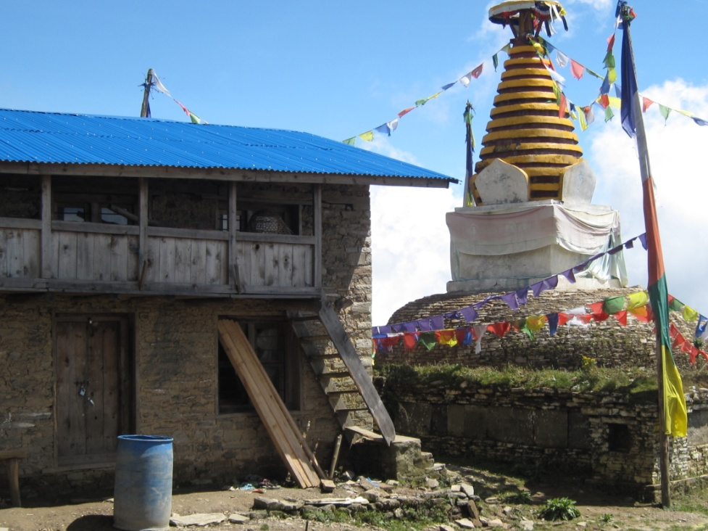
Challenges: Increasing Illegal occupation

Slide 48
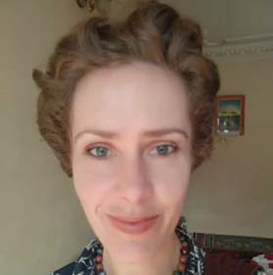
APPEAL CONTACT INFORMATION
For more information on projects you’d like to get involved with,
please contact us at:
EMAIL: tolugompa@gmail.com
FACEBOOK: @tolugompa / @donghaktharling
WHATSAPP: 0027 84 625 5234
Head Lama
Ngawang Tsultrim
Nadia Thorn
Monastery Assistant
Notes:
We hope this Appeal has inspired you to join us, through sponsorship or volunteering, in supporting the continuation of Buddha Dharma practice and learning, and the preservation of national heritage in Eastern Nepal.

